Slide 1
Timing and Control, Instruction Cycle
(Lecture 15-16)

Slide 2
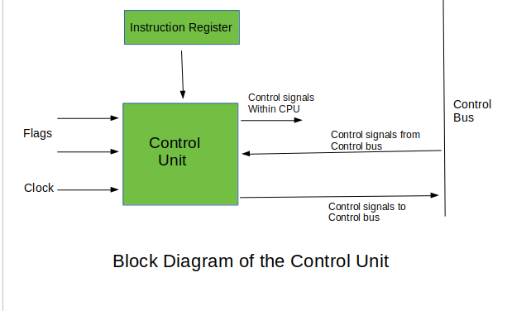

Slide 3
What is a Control Unit?
The Control Unit is the part of the computer’s central processing unit (CPU), which directs the operation of the processor. It was included as part of the Von Neumann Architecture by John von Neumann.
It is the responsibility of the control unit to tell the computer’s memory, arithmetic/logic unit, and input and output devices how to respond to the instructions that have been sent to the processor.
It fetches internal instructions of the programs from the main memory to the processor instruction register, and based on this register contents, the control unit generates a control signal that supervises the execution of these instructions.
A control unit works by receiving input information which it converts into control signals, which are then sent to the central processor. The computer’s processor then tells the attached hardware what operations to perform.
The functions that a control unit performs are dependent on the type of CPU because the architecture of the CPU varies from manufacturer to manufacturer.

Slide 4
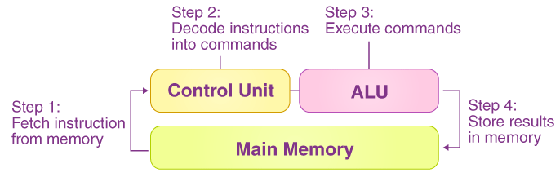
Functions of the Control Unit
It coordinates the sequence of data movements into, out of, and between a processor’s many sub-units.
It interprets instructions.
It controls data flow inside the processor.
It receives external instructions or commands to which it converts to sequence of control signals.
It controls many execution units(i.e. ALU, data buffers and registers) contained within a CPU.
It also handles multiple tasks, such as fetching, decoding, execution handling and storing results.

Slide 5
TIMING AND CONTROL
Control unit of Basic Computer
Instruction register (IR)
15
14 13 12
11 - 0
Other inputs
3 x 8
decoder
7 6 5 4 3 2 1 0
D
0
Combinational
Control
logic
I
D
Control
signals
7
T
15
T
0
15 14 . . . . 2 1 0
4 x 16
decoder
4-bit
Increment (INR)
sequence
Clear (CLR)
counter
Clock
(SC)

Slide 6
Hardwired Control
The Hardwired Control organization involves the control logic to be implemented with gates, flip-flops, decoders, and other digital circuits.
A Hard-wired Control consists of two decoders, a sequence counter, and a number of logic gates.
An instruction fetched from the memory unit is placed in the instruction register (IR).
The component of an instruction register includes; I bit, the operation code, and bits 0 through 11.
The operation code in bits 12 through 14 are coded with a 3 x 8 decoder.
The outputs of the decoder are designated by the symbols D0 through D7.
The operation code at bit 15 is transferred to a flip-flop designated by the symbol I.
The operation codes from Bits 0 through 11 are applied to the control logic gates.
The Sequence counter (SC) can count in binary from 0 through 15.

Slide 7
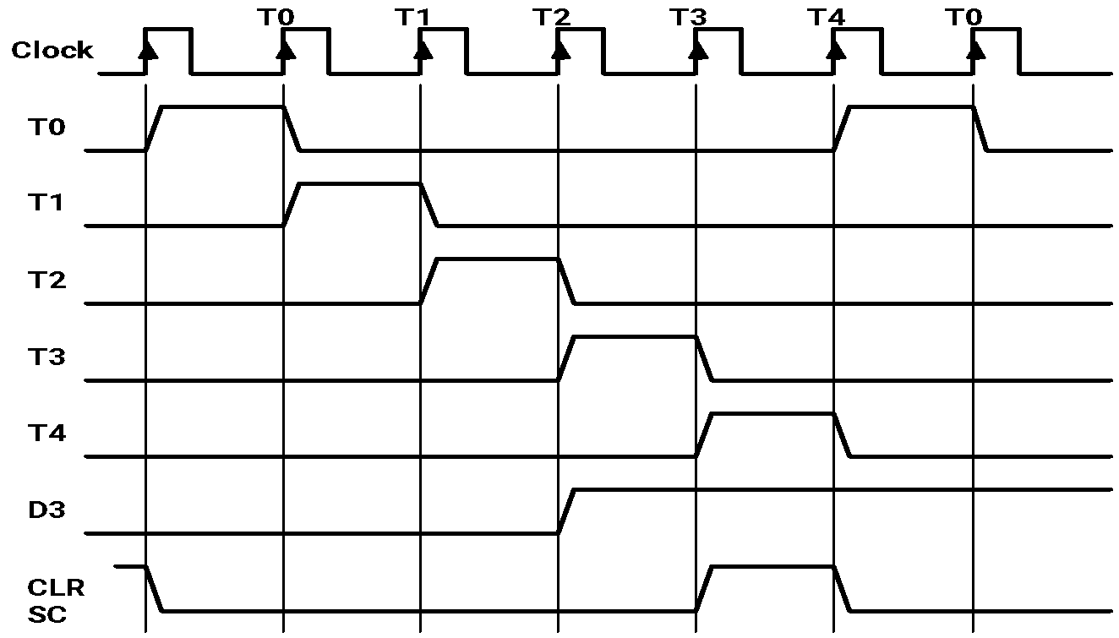
TIMING SIGNALS
- Generated by 4-bit sequence counter and 4×16 decoder
- The SC can be incremented or cleared.
- Example: T₀, T₁, T₂, T₃, T₄, T₀, T₁, . . .
Assume: At time T₄, SC is cleared to 0 if decoder output D3 is active.
D₃T₄: SC ← 0

Slide 8
INSTRUCTION CYCLE
In Basic Computer, a machine instruction is executed in the following cycle:
Fetch an instruction from memory
Decode the instruction and calculate effective address (EA)
Read the EA from memory if the instruction has an indirect address
(Fetch operand)
4. Execute the instruction
After an instruction is executed, the cycle starts again at step 1, for the next instruction
Note: Every different processor has its own (different) instruction cycle

Slide 9
DETERMINE THE TYPE OF INSTRUCTION
Start
SC ← 0
AR
←
PC
T0
T1
IR
←
M[AR],
PC
←
PC + 1
T2
Decode Opcode in IR(12-14),
AR
←
IR(0-11),
←
I
IR(15)
(Register or I/O) = 1
D7
= 0 (Memory-reference) =>opcode ≠ 111
(I/O) = 1
= 0 (register)
(indirect) = 1
= 0 (direct)
I
I
T3
T3
T3
T3
Execute
Execute
AR
←
M[AR]
Nothing
input-output
register-reference
instruction
instruction
SC
←
0
SC
←
0
Execute
T4
memory-reference
instruction
SC
←
0
D'7IT3: AR ← M[AR]
D'7I'T3: Nothing
D7I'T3: Execute a register-reference instr.
D7IT3: Execute an input-output instr.

Slide 10
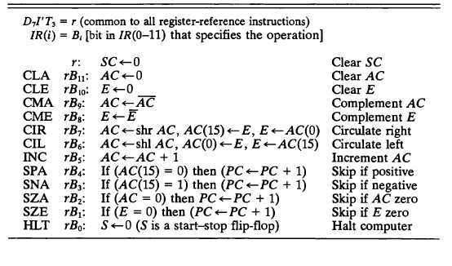
REGISTER REFERENCE INSTRUCTIONS
Register Reference Instructions are identified when
- D₇ = 1, I = 0
- Register Ref. Instr. is specified in b₀ ~ b₁₁ of IR
- Execution starts with timing signal T₃

